Slide 1
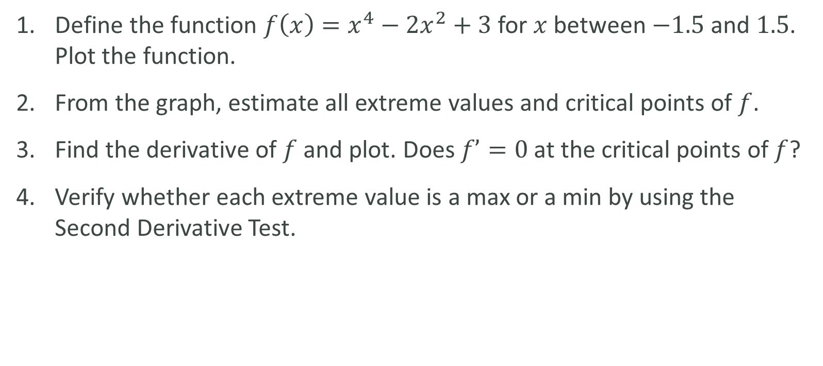
LAB
Define the function $f\left(x\right)=x^{4}−2x^{2}+3$ for $x$ between $−1.5$and $1.5$. Plot the function.
From the graph, estimate all extreme values and critical points of $f$.
Find the derivative of $f$and plot. Does $f’=0$at the critical points of $f$?
Verify whether each extreme value is a max or a min by using the Second Derivative Test.

